Slide 1
Web Scraping Fortune 500 Archive
Feb 2019
Web Scraping project at NYCDSA

Slide 2
Goal
Be able to scrape Fortune 500 archive website
Clean the scrapped data and organize
Utilize the data for analysis
Big question:
Will following additions and deletions from Fortune 500 help with investing?

Slide 3
Scraping using Scrapy

Slide 4
What’s Involved
Simple to moderate complex site to scrape
57 Years of data
5 Page navigations per year
3 different HTML/CSS formats
500 links per year for details (Links scraped, but not crawled as the data is not needed for my analysis)

Slide 5
What I Tried with Scrapy
One output file per year – Helps with rerun only for required years
Use Input and Output processors
Abstract the 3 different XPATH formats to match the HTML/CSS

Slide 6
Analysis of Fortune 500 Data

Slide 7
About the Data
Sparse – most companies appear only for few years out of 58 years
Charts have spread out data with varying starting and end points – difficult to compare
Relative size of revenue/profits vary by large amounts, skewing the charts
Different names used for companies across years

Slide 8
Word of Caution
Limited nature of analysis using only two parameters revenue and profits
Great Recession of 2008 skews trends for recent years
You will be sick of line plots by the end of this presentation

Slide 9
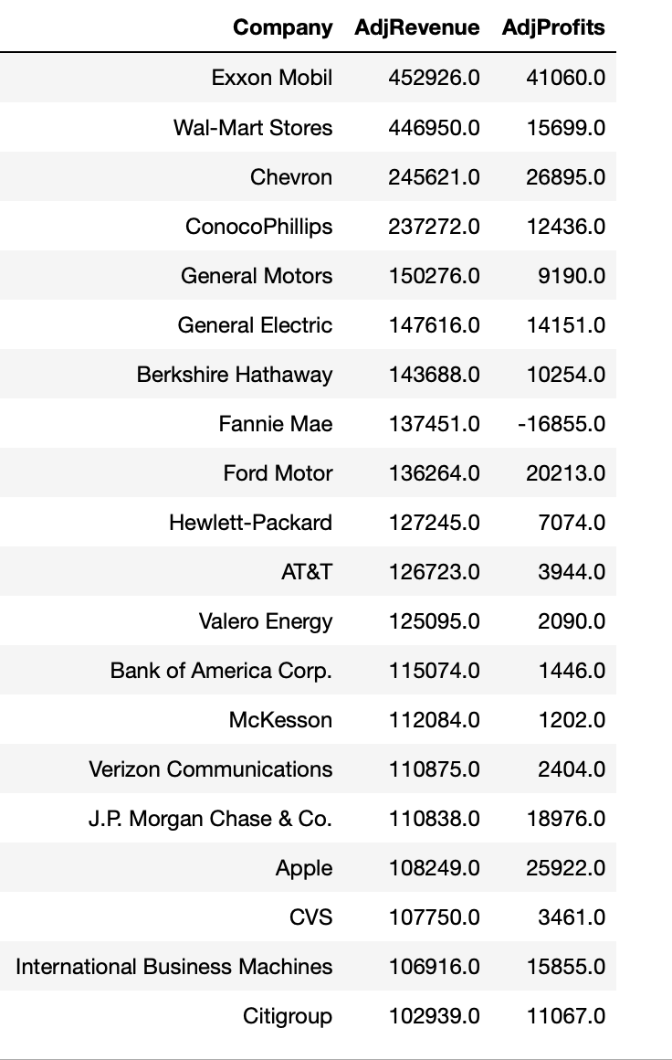
A quick look at what made the top 20 in 2012

Slide 10
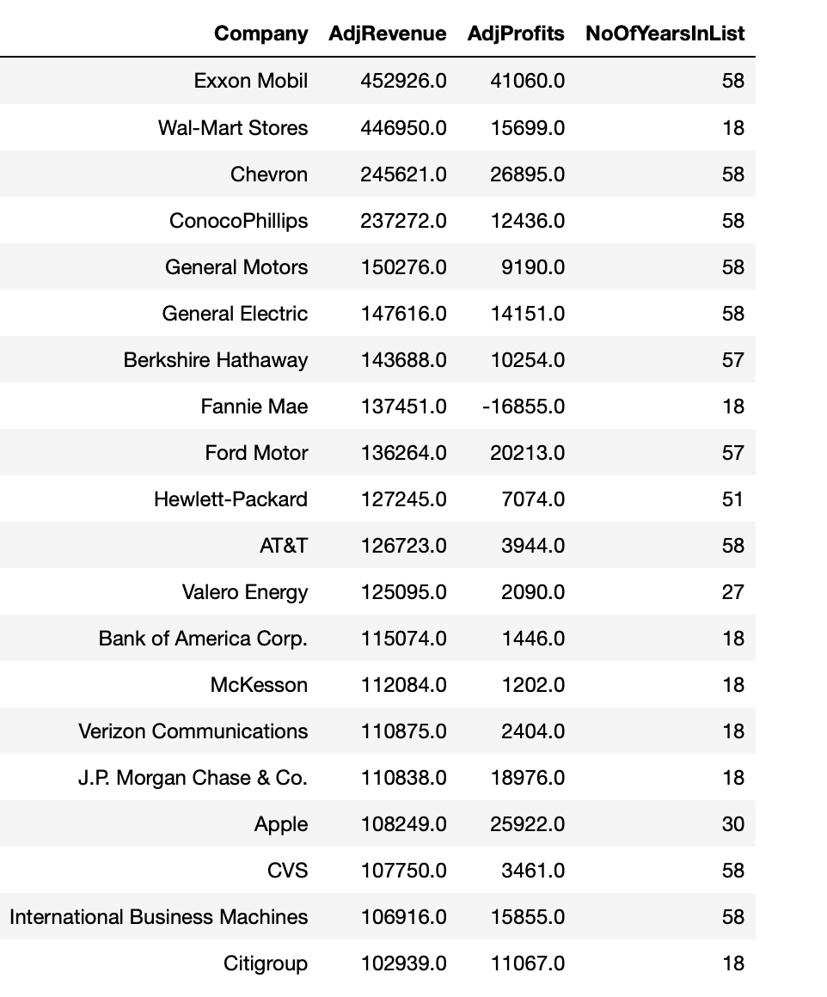
How about we look at how long they have been in the list..
Looks pretty stable

Slide 11
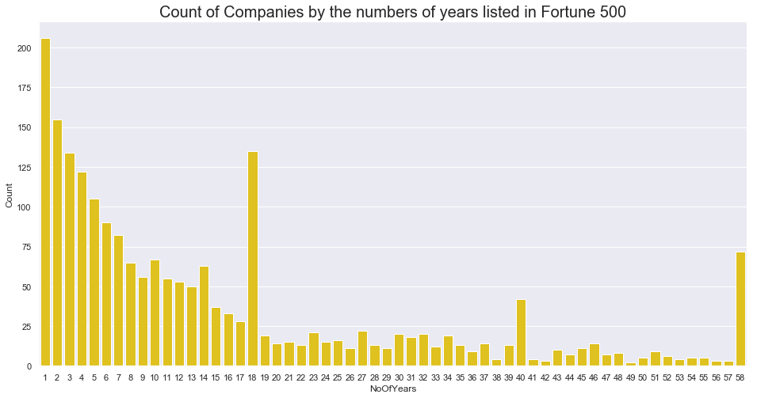
Not so fast!
Most companies get dropped with in few years after making it to the list

Slide 12
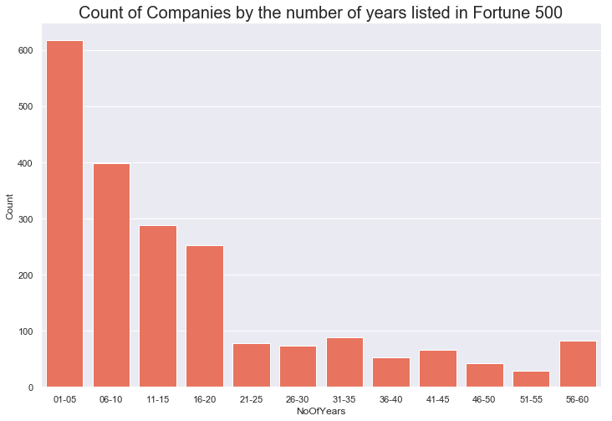
Another view, in 5 year bins

Slide 13
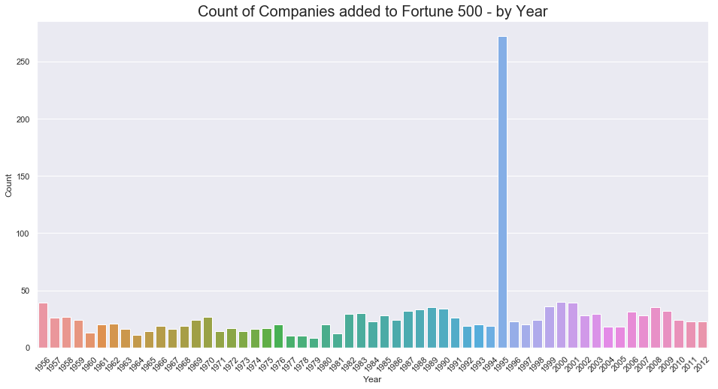
On Average there is 5% to 10% churn in the companies listed in Fortune 500
1995 seems like some kind of methodology change resulting in spike

Slide 14
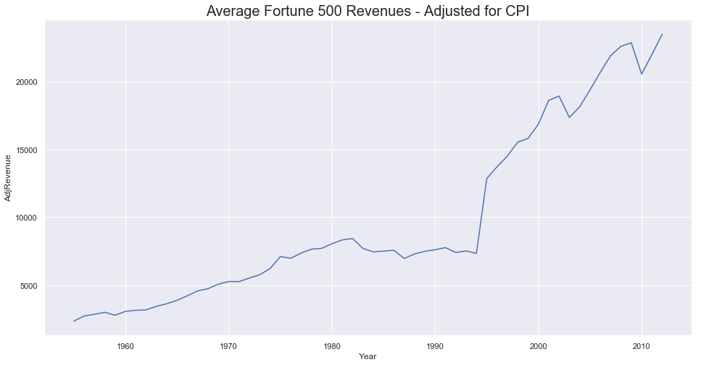
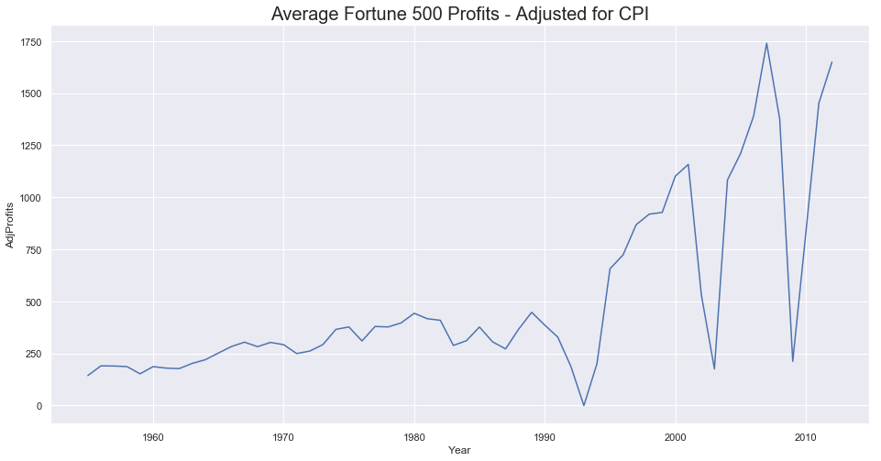
Let us start deep dive with average Revenue and Profits

Slide 15
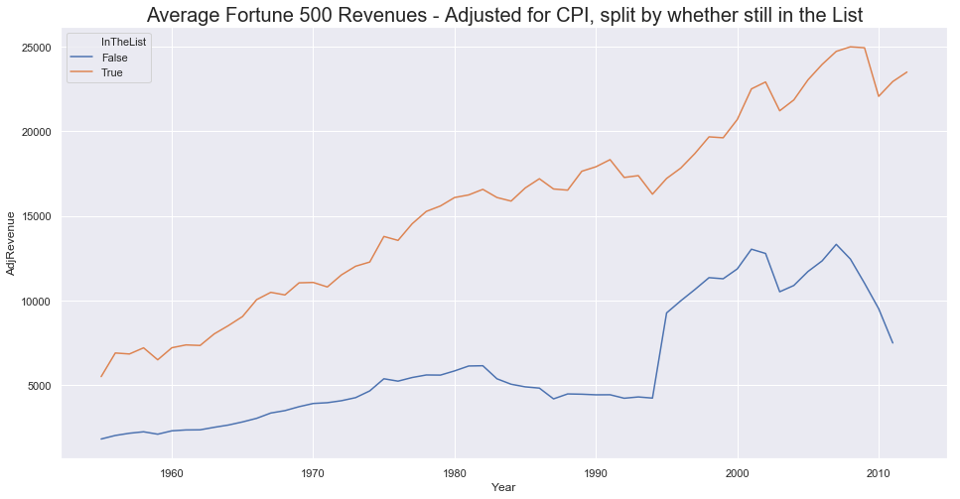
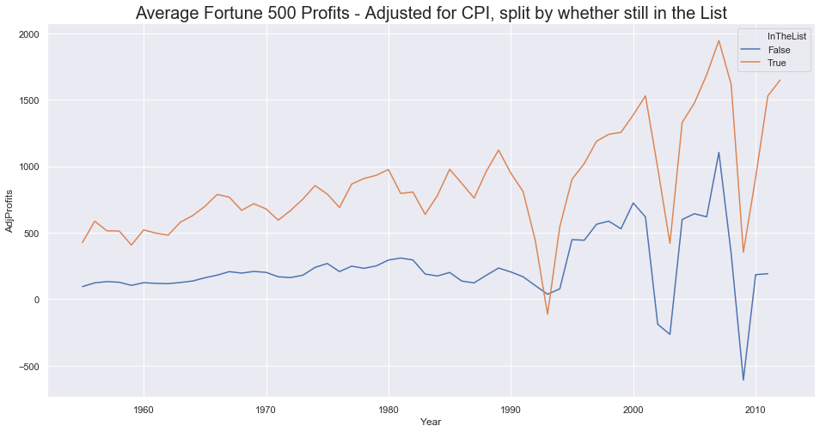
However, there is considerable gap between Companies that are still in the list and that are not

Slide 16
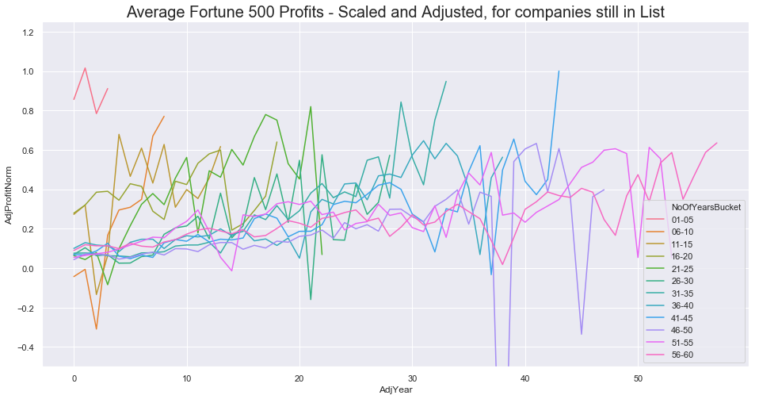
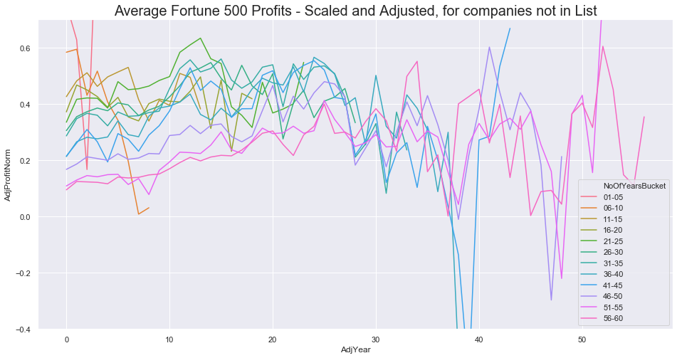
Profits by period bins – relatively trending up for companies still in the list

Slide 17
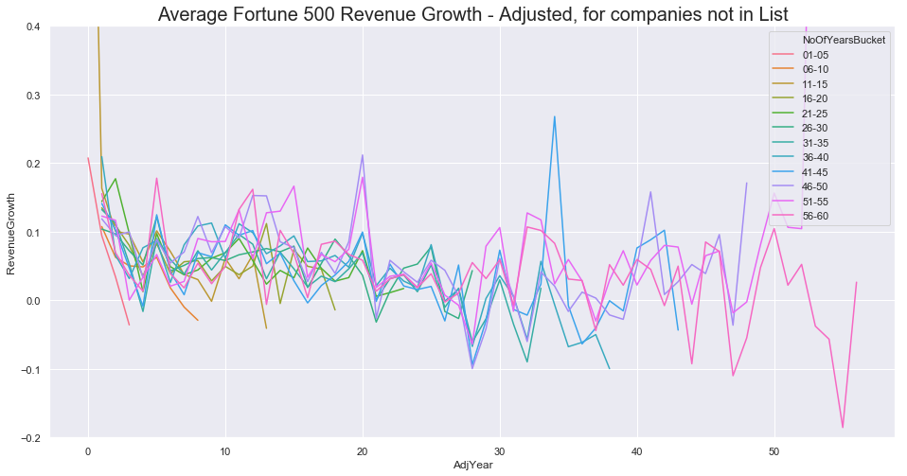
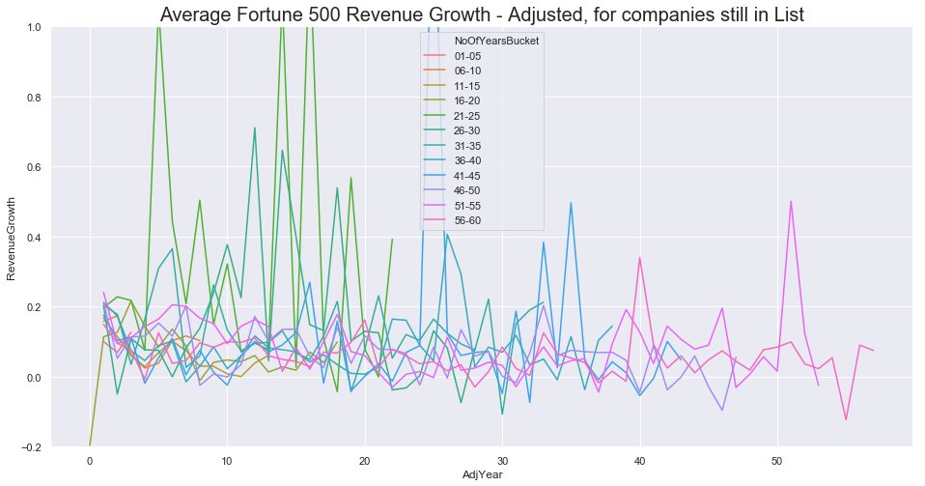
Revenue by period bins – relatively trending up for companies still in the list

Slide 18
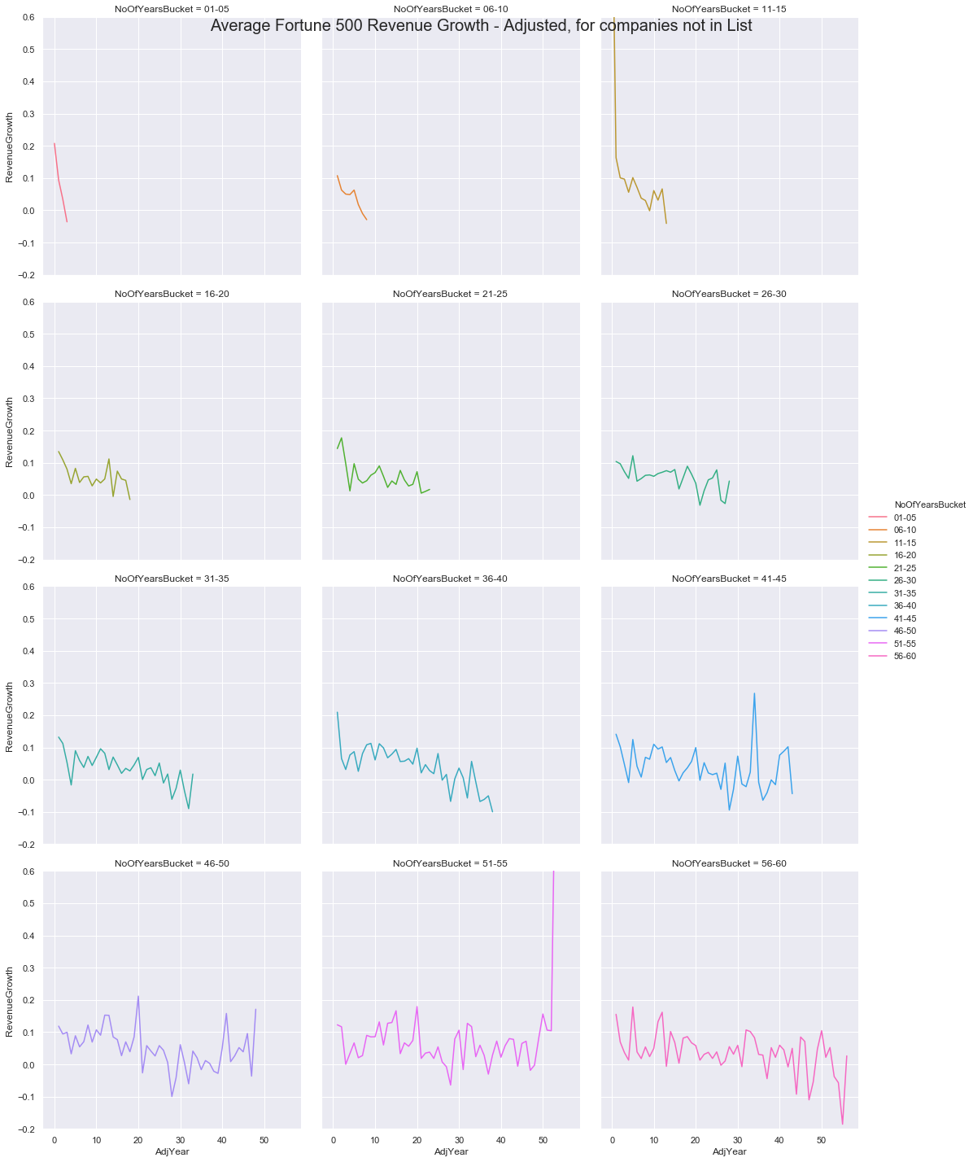
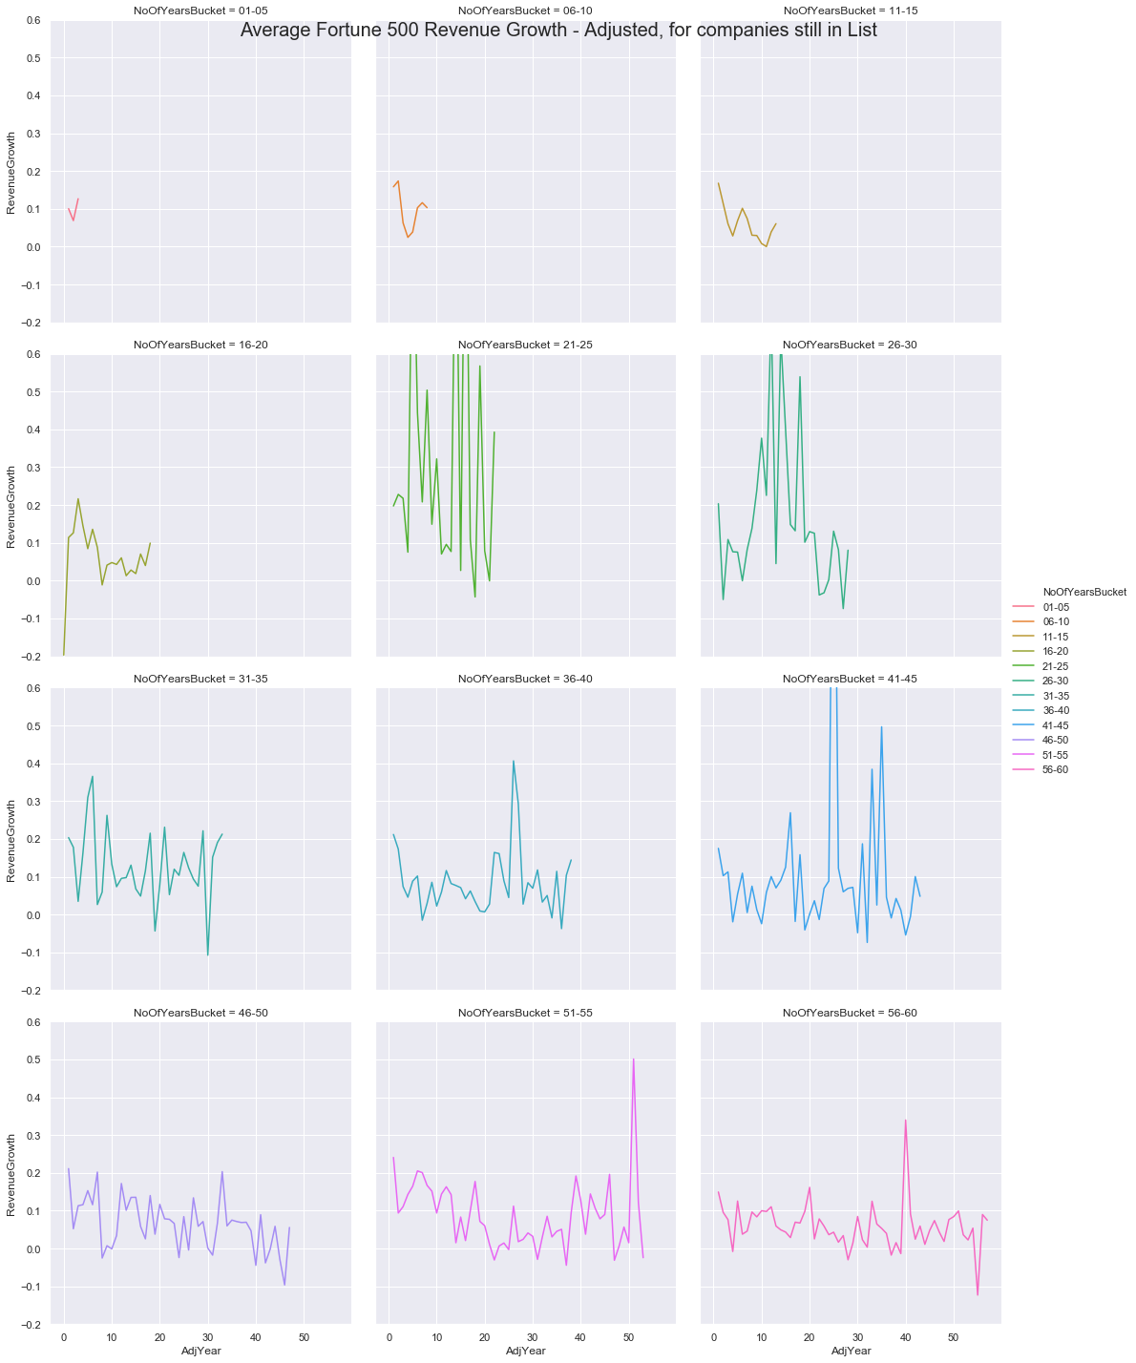
Revenue by period bins – relatively trending up for companies still in the list

Slide 19
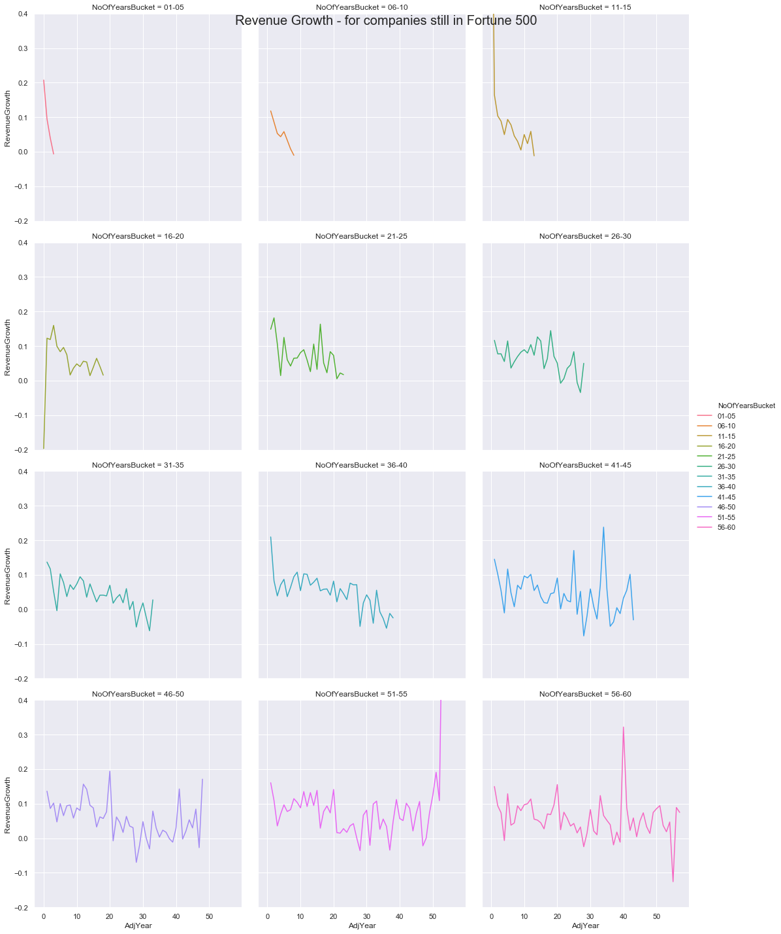
To be more concrete, let us look at 2012 list

Slide 20
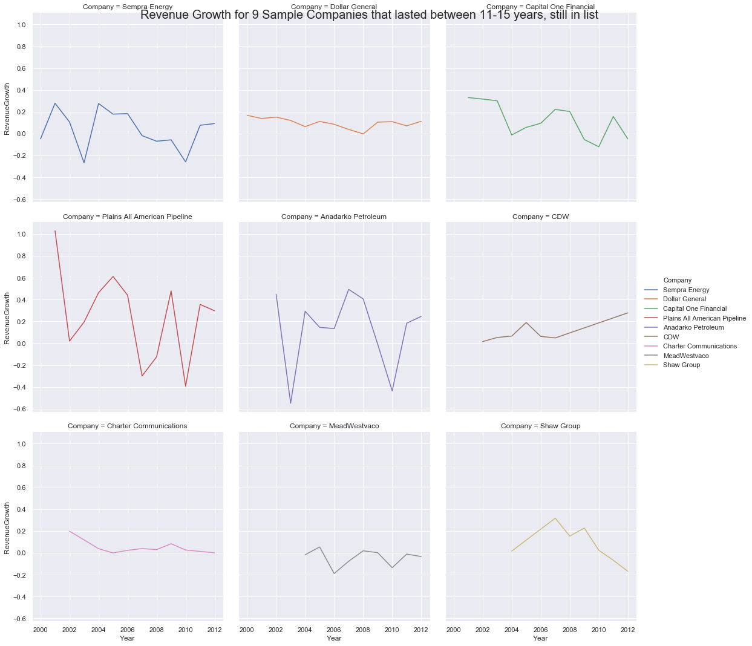
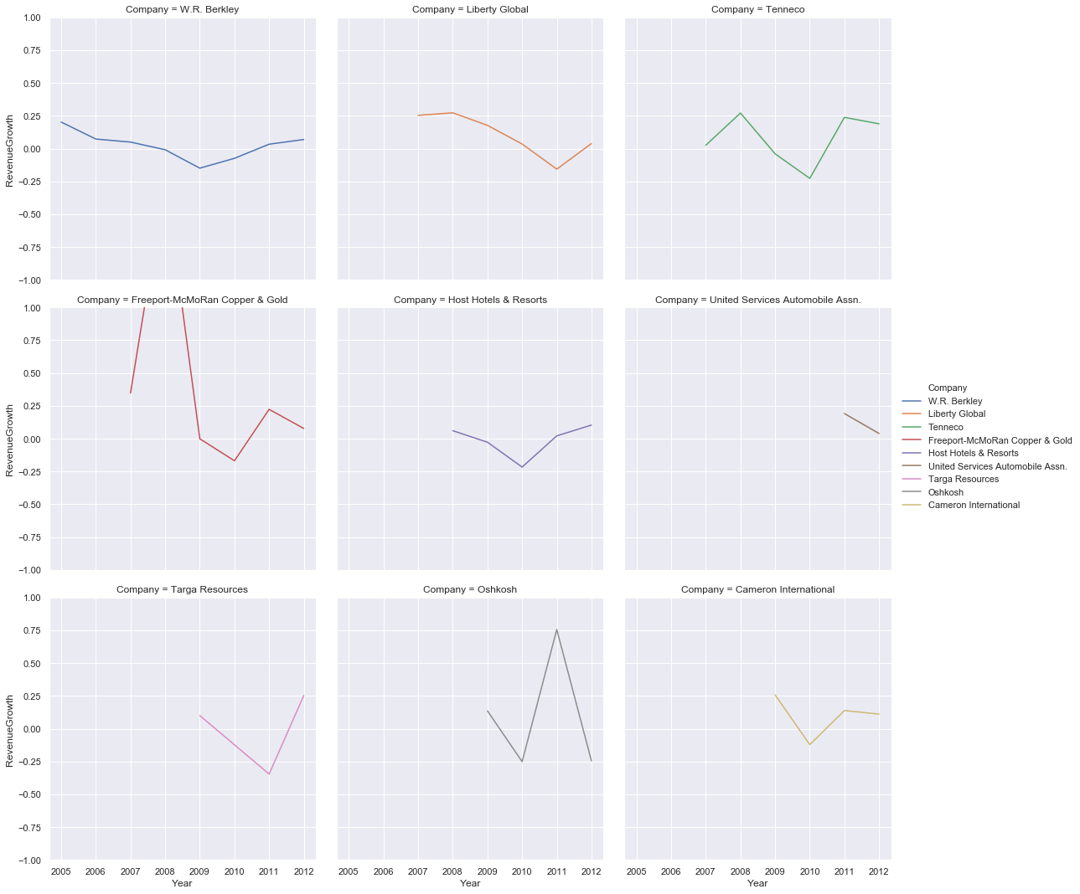
2012 list –
companies that are in 11-15 years group and still in the list, we can notice, high growth rates. For in 6-10 years group, growth rates are even higher, but volatile
Note that, there was "Great Recession of 2008" during this time.

Slide 21
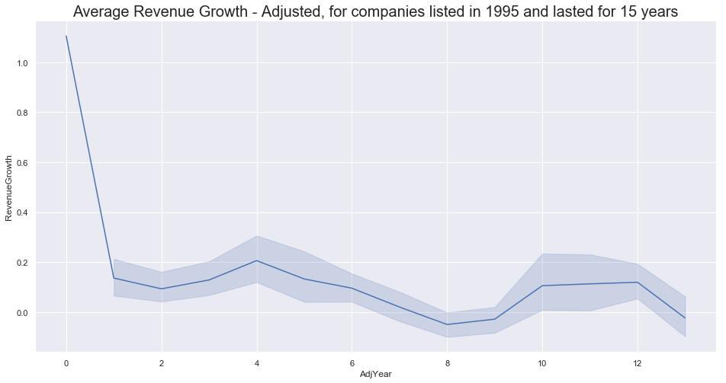
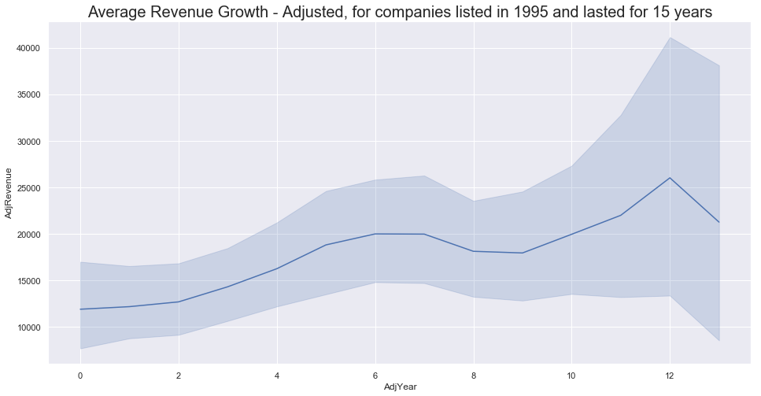
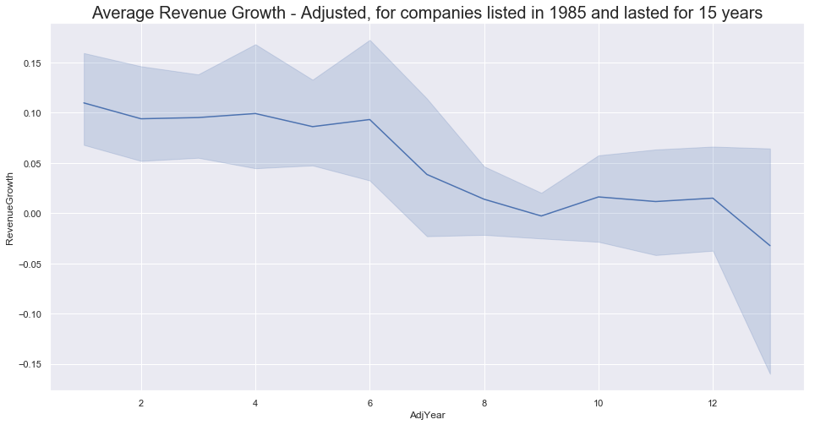
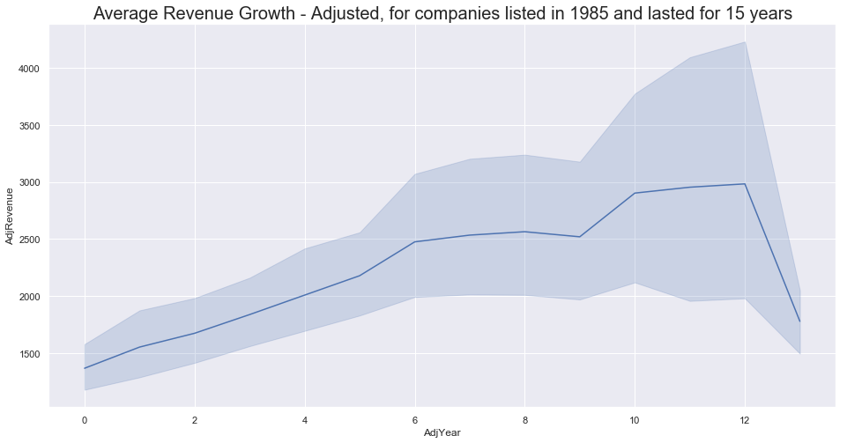
Picked two years 1995 and 1985 and all the companies that are in the list that year and also hit 15 years overall

Slide 22
Conclusion
There is lot of growth left in companies after being added to Fortune 500 list
Companies added newly or in recent years is a good started list for further research
Be aware of the high churn in early years
Other than this, there are no other definitive conclusions to be drawn

Slide 23
Future Work
Analysis using more parameters
Better trendlines in charts
Scraping with database as backend

Slide 24
Links
Github : https://github.com/radhavrmk/WebScrapeProject.git
Data : https://money.cnn.com/magazines/fortune/fortune500/2011/index.html

